Slide 1
Cost Effectiveness Analysis and Cost Benefit Analysis -
A Ganar in Honduras
Bingying Wu, University of Maryland
Client: Social Impact, Inc.
May 16th, 2017
The World Bank, Washington D.C.

Slide 2

A Ganar Program
Overview
  Youth workforce development and employability skills through sports
  Honduras and Guatemala
Notes:
3 cohorts, two countries,

Slide 3
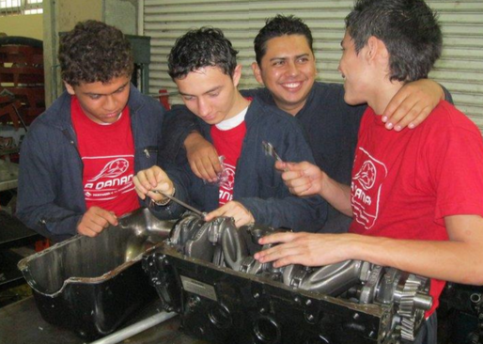
Objectives
Employment
Return to school
Start own business

Slide 4
Research Questions
How effective does the A Ganar program help youth participants develop employability skills?

Slide 5
Cost-Effective Analysis
The average cost effectiveness = Net Effectiveness/ Net Cost
Cost- 6 partner organizations
  Total grants/ number of participants= Average cost $381.44
Notes:
For the cost of this program, we assume that the total amount of grants given to each partner organization was all spent on the program. For the future analysis, it would be helpful to know the exact breakdown of expense

Slide 6
Cost of 1% decrease in self-risk behaviors
*Not statistically
significant
Notes:
ADD *******

Slide 7
Cost of 1% increase in wages

Slide 8
Other outcomes
Developmental Asset Profile
Capabilities Index
Entrepreneurship outcomes
Education outcomes

Slide 9
Comparison Between Programs
Monthly Wages Increase
No Significant Monthly Wages Increase
Dominican Republic
Peru
Colombia
Panama
Argentina
Mexico
Notes:
Among the IABD-sponsored programs, the Juventud y Empleo (JE) program in the Dominican Republic [ Youth and Employment]
Colombia program “Jóvenes en Acción” (IDB & WB) Youth in Action
Peru YOUTH LABOR TRAINING PROGRAM” - PROJOVEN

Slide 10
Country | Program | Funder | Time | Months between training and data collection | # of Participants | Cost/Youth | Paper
DR | the Juventud y Empleo (JE) | IDB | 2004 | 10-14 and 22-24 months | 5,757 | $330 | Card et al. (2007)
Peru | PROJOVEN | IDB | 2001 | 6,12 and 18 months | 14,791 | $575 | D ́ıaz and Jaramillo (2006)
Colombia | Jóvenes en Acción | IDB & WB | 2005 | 19-21 months | 26,615 | $875 (women) $924.7 (men) | Attanasio et al. (2008)

Slide 12
Data for future collection
Identifying Benefits
Potential Data Source
Incarceration
Opportunity cost
Fighting crimes
Income yielded by improved skills
Health benefit
Future Education
  National Police of Honduras
  Future Survey

Slide 13
Questions?

Slide 14
Plan for Cost Benefit Analysis
 | To Participants |  | To Government |  | To Society
A Ganar cost |  |  | ($381.44)
Education cost saving
Welfare reduction
Crime reduction |  |  | -
Earnings increase | $171.77
5 years projection
College costs
Earnings increase
Welfare reduction
Crime Reduction

